Slide 1

Term Project
CMPT 318
Michael Kuby, Harsh Behal

Slide 2
Introduction
Hidden Markov Modeling (HMM) for anomaly detection
Supervisory control systems : Automation of critical infrastructure
Multivariate time series of Global Electricity Usage
Use of Principal Component Analysis (PCA)
Training Models using PC’s
Time window
Tuesday 03:00 – 06:00

Slide 3

Response Variable Analysis Via PCA
Feature analysis technique
Useful for feature analysis
Can be used to reduce dimensionality
Principal components are linear combinations of the original features
Principal components are completely uncorrelated
Helps to reveal what features explain the data’s variation

Slide 4
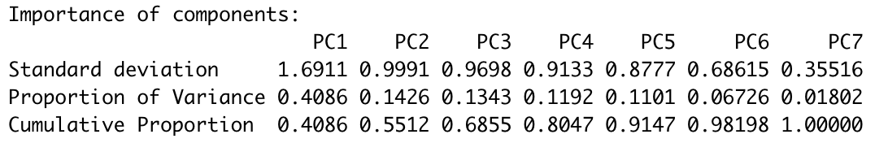
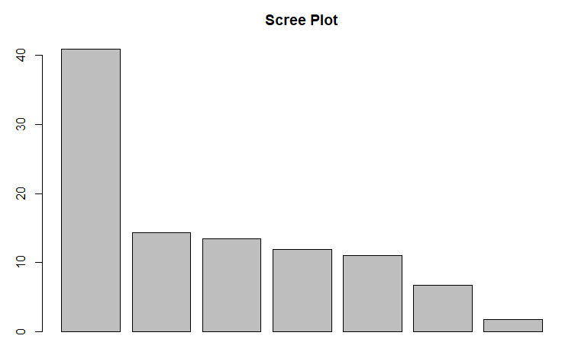
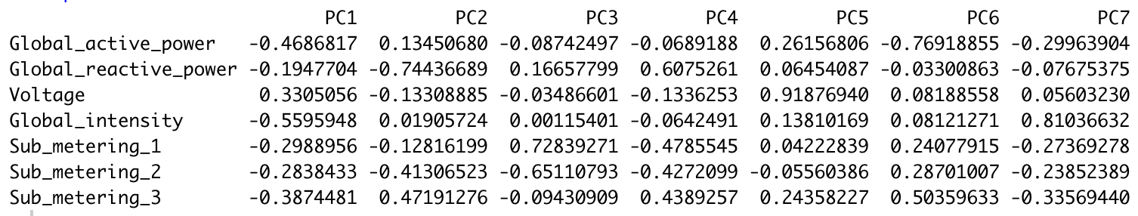
Results
PC1-PC3 : Explains 68.55% of total variance in the data
PC1: Global_intensity, Global_active_power and Sub_metering_3
Highest impact features
PC2: Global_reactive_power
How do we choose features?

Slide 5
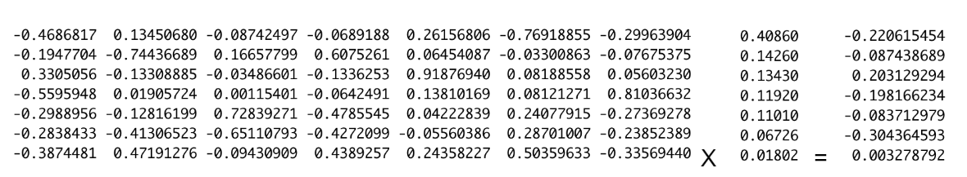
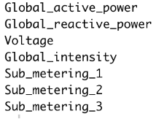
How do we choose features?
Creative approach (Suggested by Amir)
Think of loading values as a matrix
Variance values corresponding to each PC as a column vector
Perform matrix multiplication
Creates feature variance
Features with the greatest impact on data variation:
1) Sub_metering_2 - 0.3044
2) Global_active_power - 0.2206
3) Voltage 0.2031
4) Global_intensity - 0.1981

Slide 6
Alternative Approach
Use PCAs themselves as the feature training model
PCs 1-3 explains 68.55%
Each of the PCxs by nature is guaranteed to be wholly uncorrelated
We can determine the log-likelihood values of sequences given an HMM (The question we are trying to answer)
Inference is challenging

Slide 7
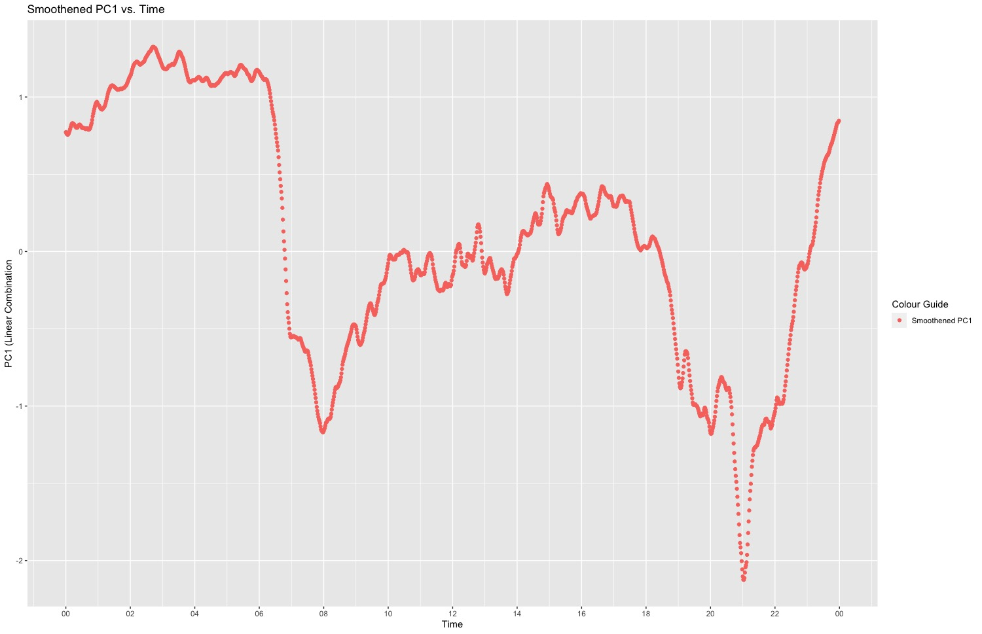
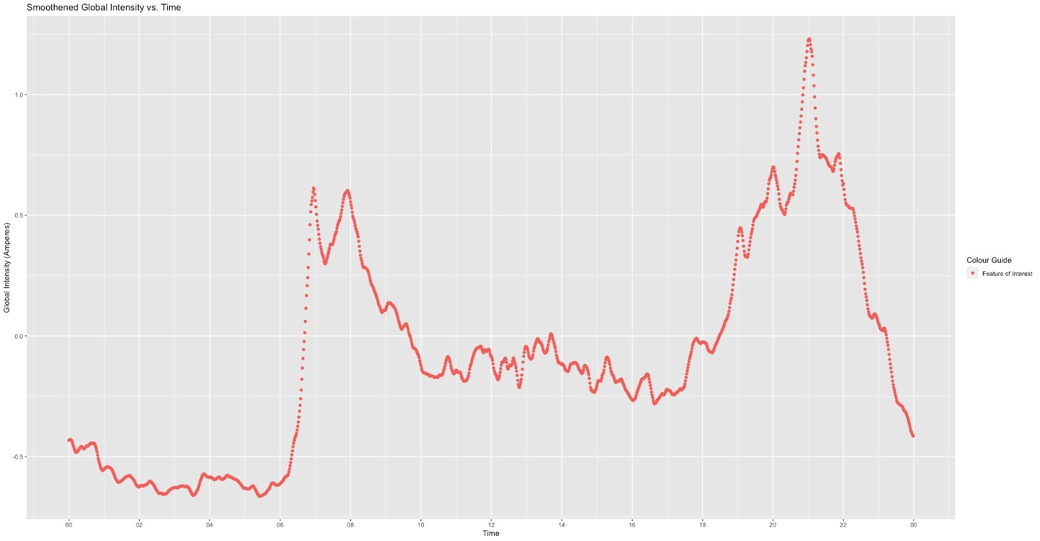
Observation Time Window
Choice : Tuesday (heart of the work week)
In these graphs we noticed an inverse relationship
Smoothened Global Intensity vs Time
Smoothened PC1 vs Time
Time : 03:00 – 06:00
Relatively calm

Slide 8
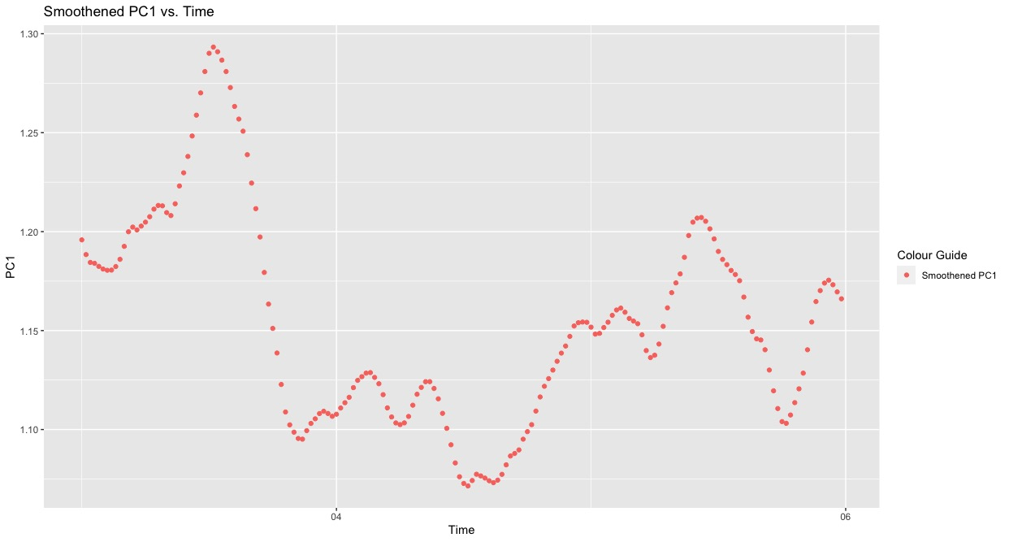
Smoothened PC1: Tuesday, 03:00 – 06:00
Positive value
Small amount of variation

Slide 9

Data Partitioning
70:30 Train to Test
Sequence is important!
Train
107 contiguous weeks
Starting late 2006 - 2008
Test
47 contiguous weeks beginning at the start of 2009

Slide 10
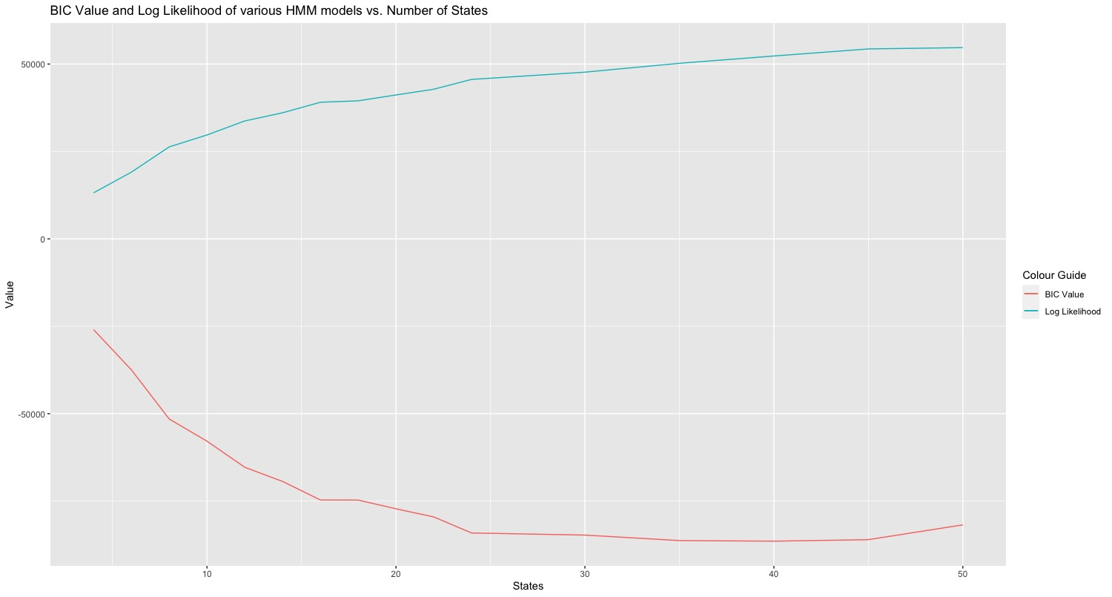
HMM Training and Assessment: Train Data
Goals:
Maximize log likelihood
Minimize BIC
Analysis:
After the 40th state we see BIC values begin to positively regress
24 state vs 40 state?

Slide 11
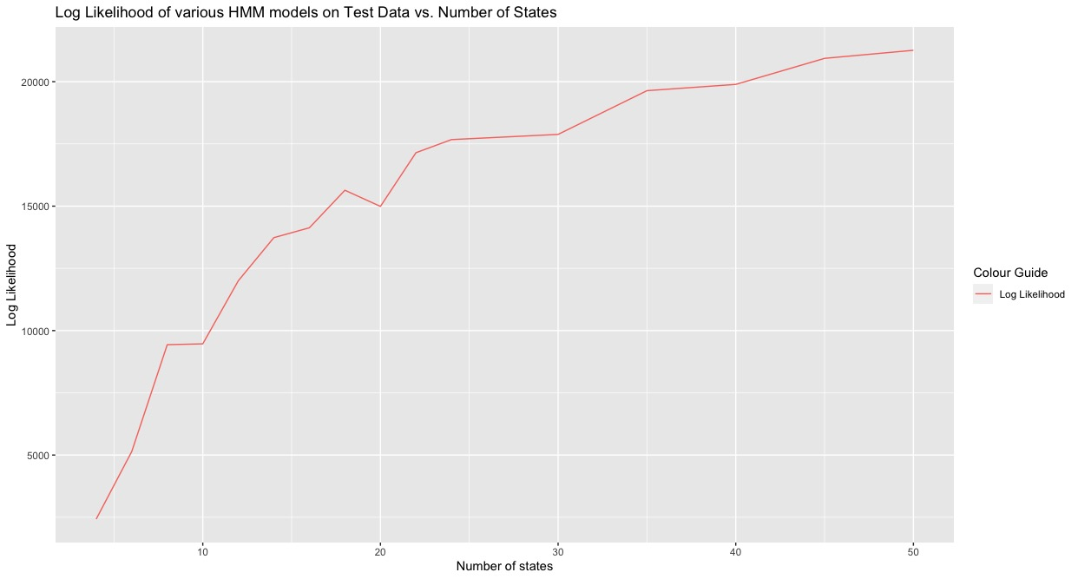
Performance on Test Data
More is still better?
50-state Model performed the best
Limited benefit from more than 24 state models

Slide 12
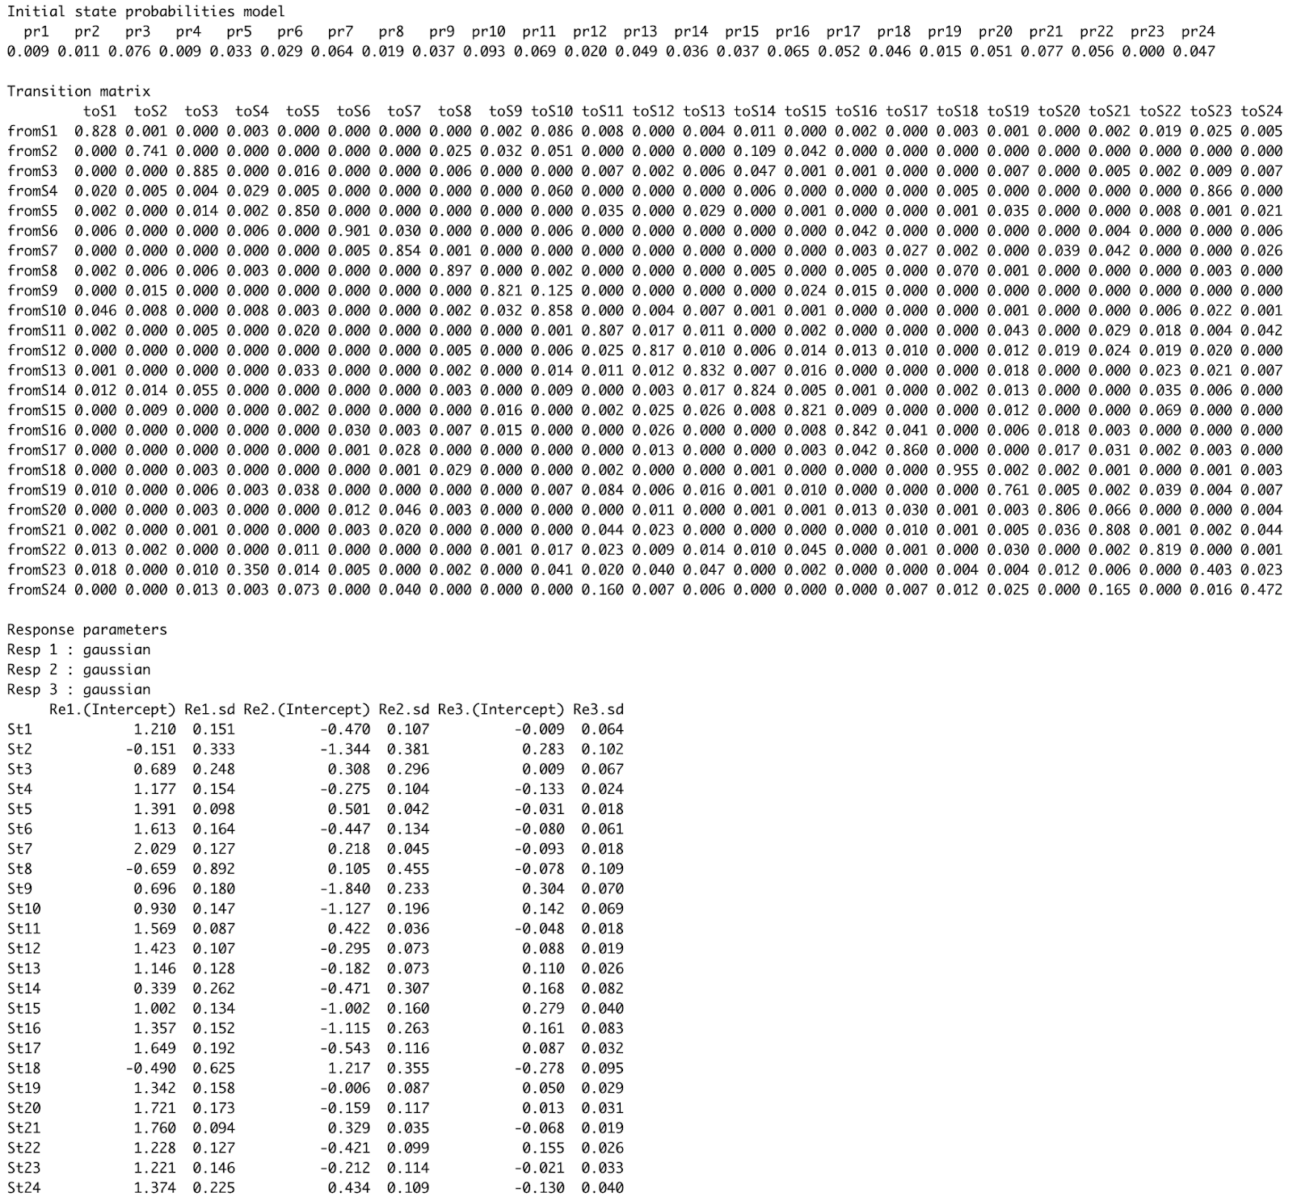
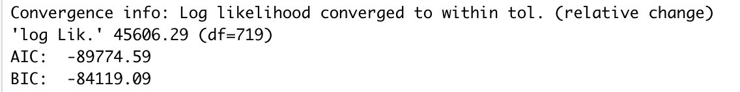
Best Choice : 24-State Model
Real world accuracy
Simplicity
Tapering benefits from more than 24 states
Good relative performance
Train data: 45606.29 / 19260 = 2.370
Test data: 17673.86 / 8460 = 2.089

Slide 13
Anomaly Detection : Most to least
DataWithAnomalies2.txt
Log-likelihood : -0.2809
Benchmark: 2.089

Slide 14
Anomaly Detection : Most to least
DataWithAnomalies1.txt
DataWithAnomalies2.txt
Log-likelihood : -0.3510
Log-likelihood : -0.2809
Benchmark: 2.089

Slide 15
Anomaly Detection : Most to least
DataWithAnomalies3.txt
DataWithAnomalies1.txt
DataWithAnomalies2.txt
Log-likelihood : NaN (impossible?)
Log-likelihood : -0.3510
Log-likelihood : -0.2809
Benchmark: 2.089

Slide 16
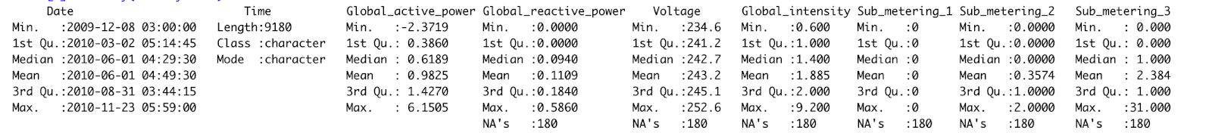
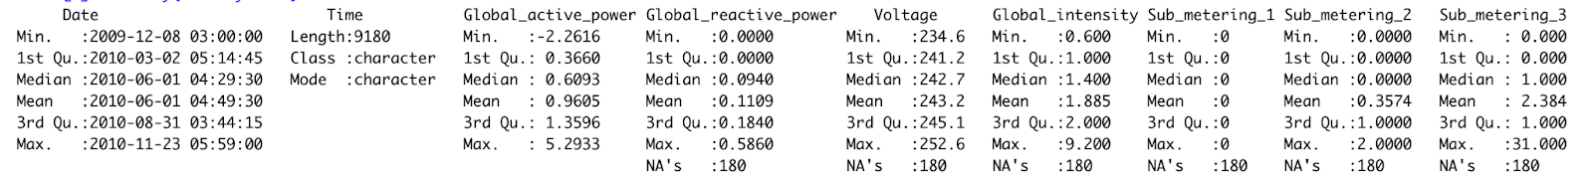

Summary inspection…
DataWithAnomalies1.txt Summary
DataWithAnomalies2.txt Summary
DataWithAnomalies3.txt Summary

Slide 17
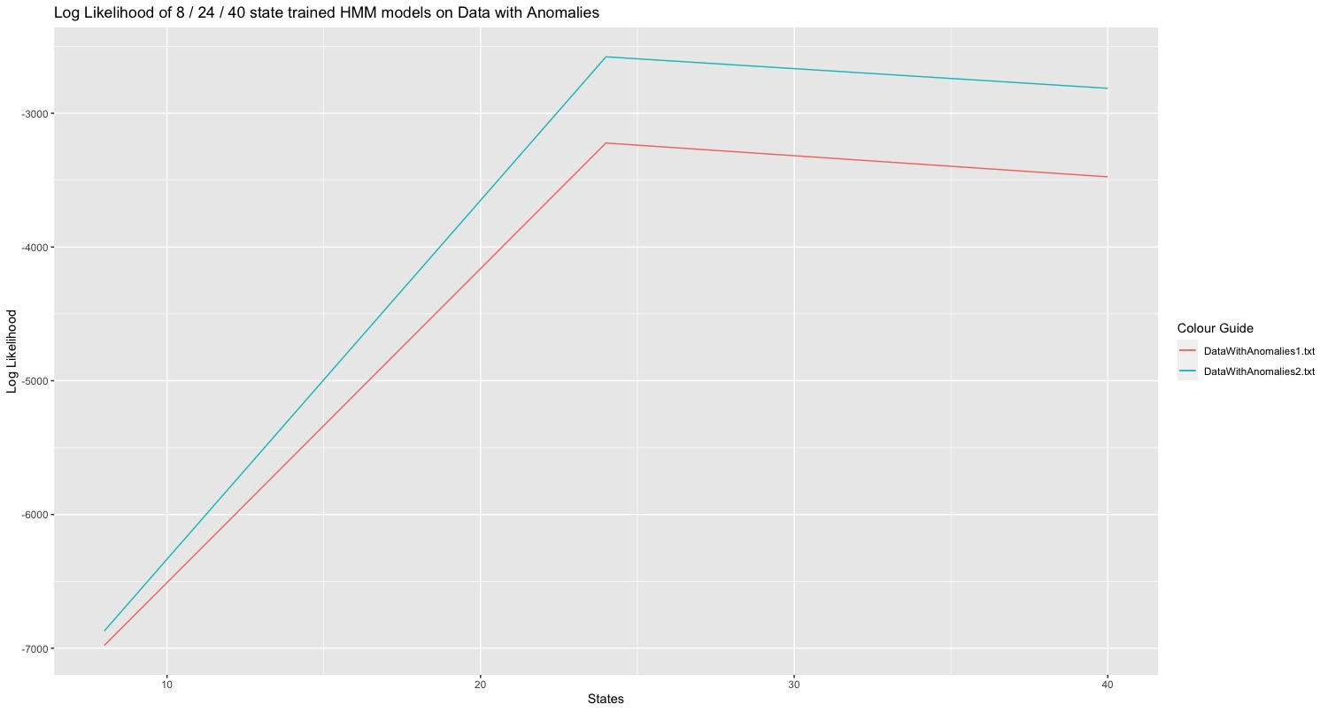
Conclusion
Our Prediction:
8-state would be worst
40-state would be best
24-state would be the best choice
24-state model performed comparatively to the 40-state model
24-state model is simpler
Our choice of 24 state was reinforced

